Slide 1

8-bit Calculator
By Team Exemplary
Asm Nurussafa
Tasawar Siddiquy Arfat Kamal
Nirojan Navaratnarajah
For the module Hardware Engineering.
Picture source: https://auto.economictimes.indiatimes.com/news/auto-components/top-10-semiconductor-buyers-increased-chip-spending-by-25-in-2021/89335809?redirect=1

Slide 2
Agenda
Introduction.
Concept description.
Technologies.
Implementation.
Results.
PCB Design + PCB Layout.
BOM list.
Summary.

Slide 3
Introduction

Slide 4
2. Concept Description

Slide 5
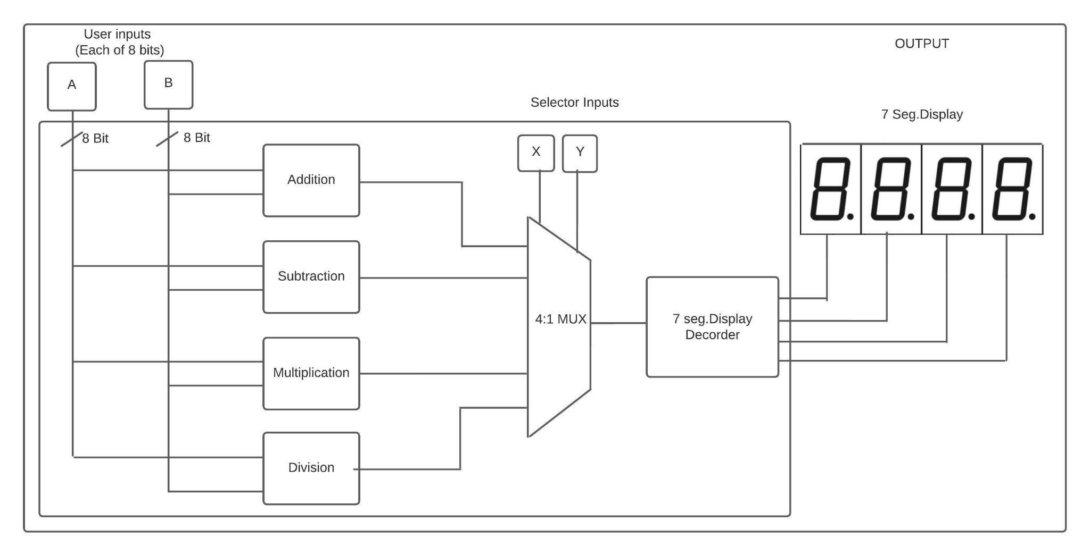
Concept
Block Diagram

Slide 6
3. Technologies

Slide 7
VHDL:
The VHSIC Hardware Description Language (VHDL) is a hardware description language (HDL) that can model the behavior and structure of digital systems at multiple levels of abstraction.
For our project is helps mainly for developing a code, checking syntax, compiling and the main advantage is that it provides the facility to simulate the code, with a very user friendly user interface.

Slide 8
AutoCAD Eagle:
EAGLE is electronic design automation (EDA) software that lets printed circuit board (PCB) designers easily connect schematic diagrams, component placement, PCB routing, and comprehensive library content.
For this project it was a requirement to design a PCB which includes integration of FPGA module ,switches for inputs, and 7 Segment displays.
We designed a two-layer PCB using AutoDesk Eagle.

Slide 9
FPGA:
FPGA (Field Programmable Gate Array) is a hardware circuit (IC’s) that a user can program to carry out one or more logical operations.
For this calculator project, the FPGA used is EP4CE22E22C8N from Intel. The library used is from Ultralibrarian.com.
FPGA specifications used:
FPGA CycloneR IV E Family.
22320 Cells 60 nm technology.
1.2 V.
144-Pin EQFP EP.

Slide 10
Xilinx ISE (Integrated Synthesis Environment):
The Xilinx ISE is primarily used for circuit synthesis and design.
The User constraint file (.ucf) is used for mapping the ports of the VHDL code with the physical pins of the FPGA.

Slide 11
4. Implementation

Slide 12
Components:
8-bit Adder.
8-bit Subtractor.
8-bit Multiplier.
(Upto 16-bit) Divider.
4:1 MUX.
BCD and 7-segment display.

Slide 13
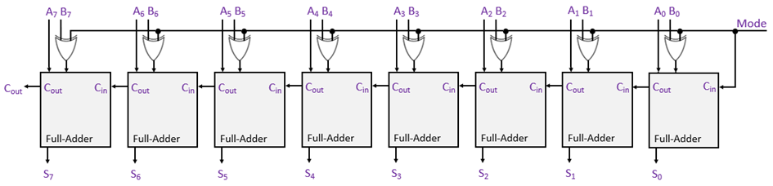
Adder/Subtractor
[2]

Slide 14
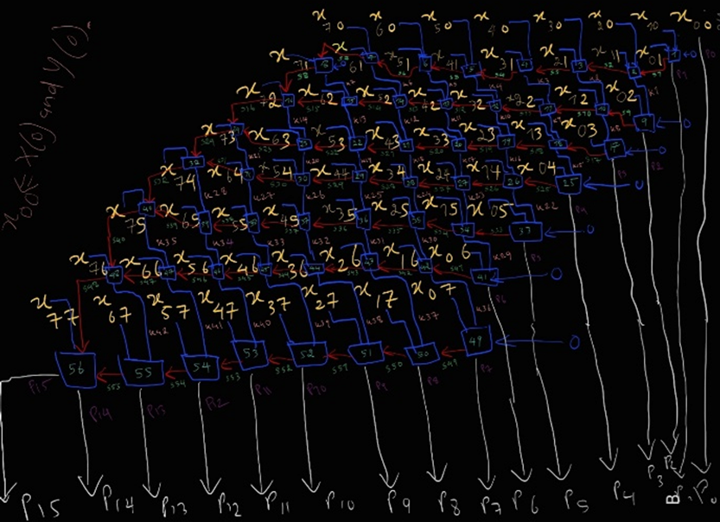
C. Multiplier
56 Full Adders

Slide 15
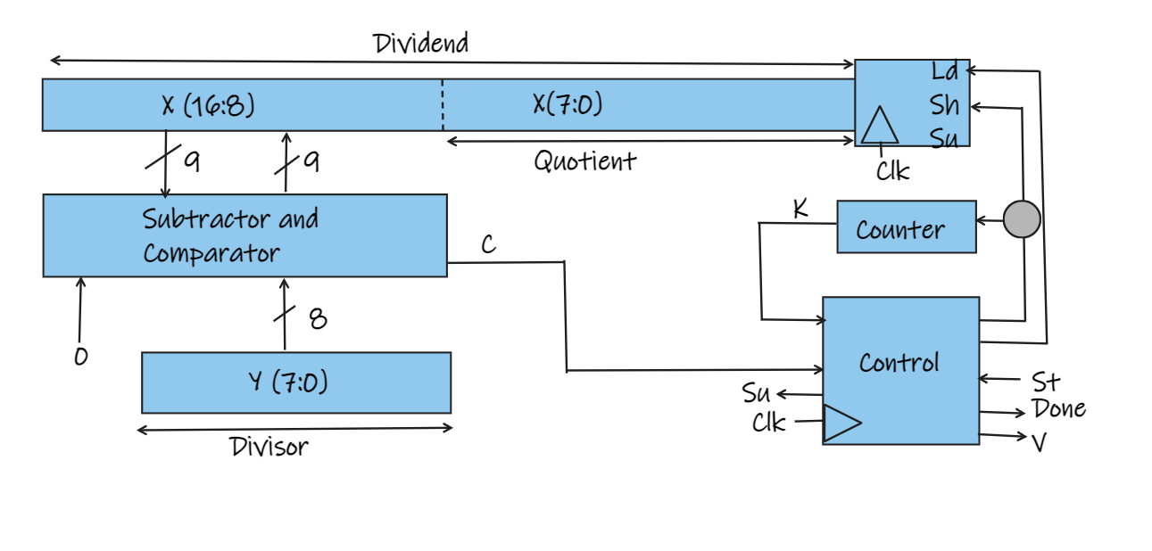
D. Divider (Block Diagram)

Slide 16
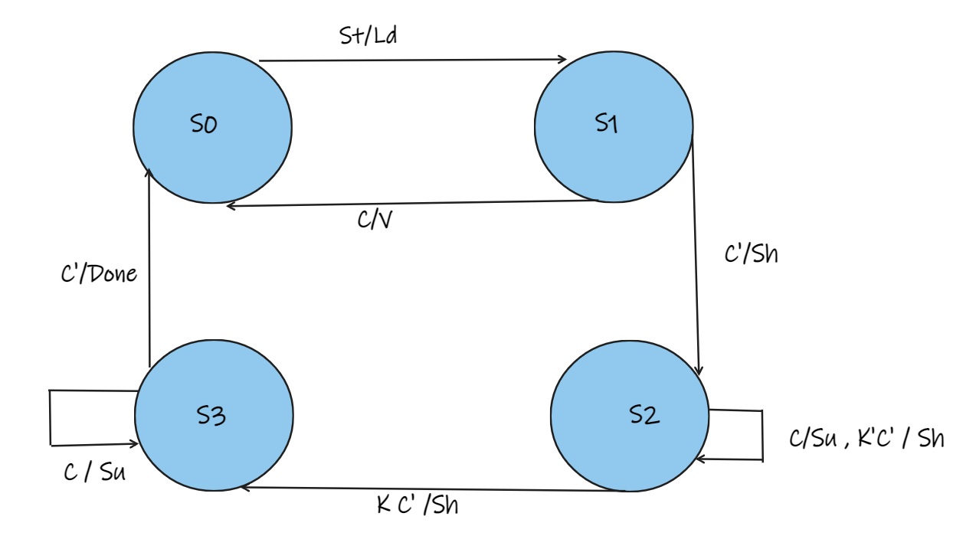
D. Divider (Finite-State Machine)

Slide 17
E. Multiplexer

Slide 18
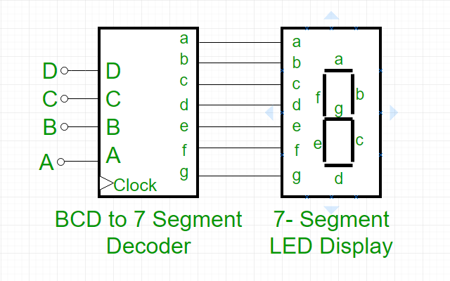
F. BCD and 7-segment display
Picture source: https://www.sxcco.com/?category_id=2970710

Slide 19
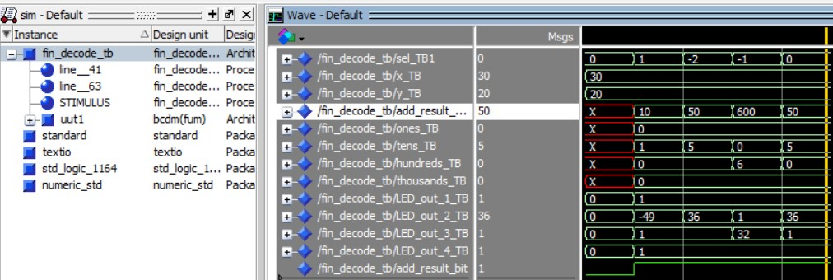
ModelSim Simulation
Input A - 30 (00011110)
Input B - 20 (00010100)
Selector - “01”- (subtraction),
“10” - (addition),
”11”- (multiplication),
”00” - (Division)

Slide 20
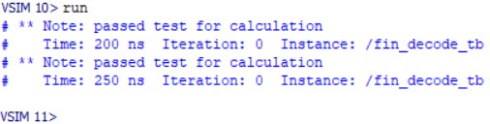
Assert/ report for verification
Severity→ NOTE/FAILURE

Slide 21
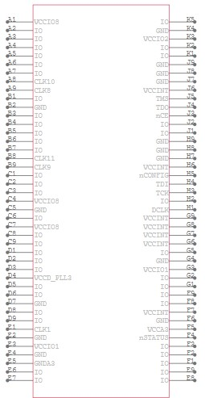
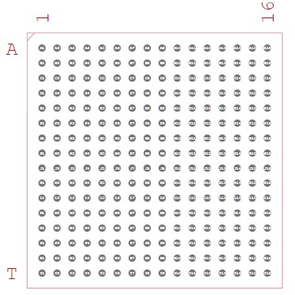

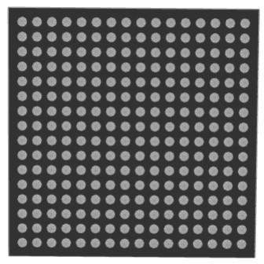
FPGA
Library downloaded from Ultralibrarian.com
EP4CE22E22C8N from Intel.
FPGA CycloneR IV E Family
22320 Cells 60 nm Technology
1.2V
144-Pin EQFP EP

Slide 22
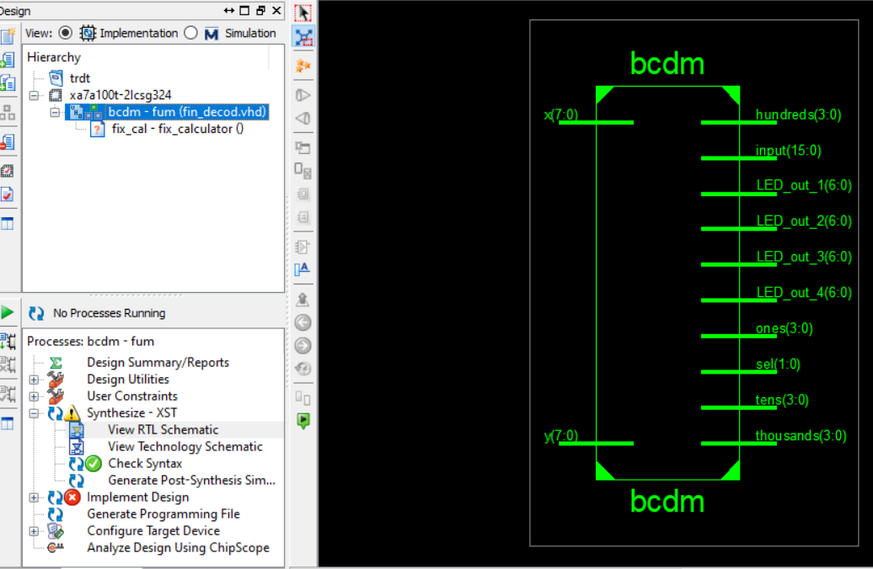
RTL Schematic

Slide 23
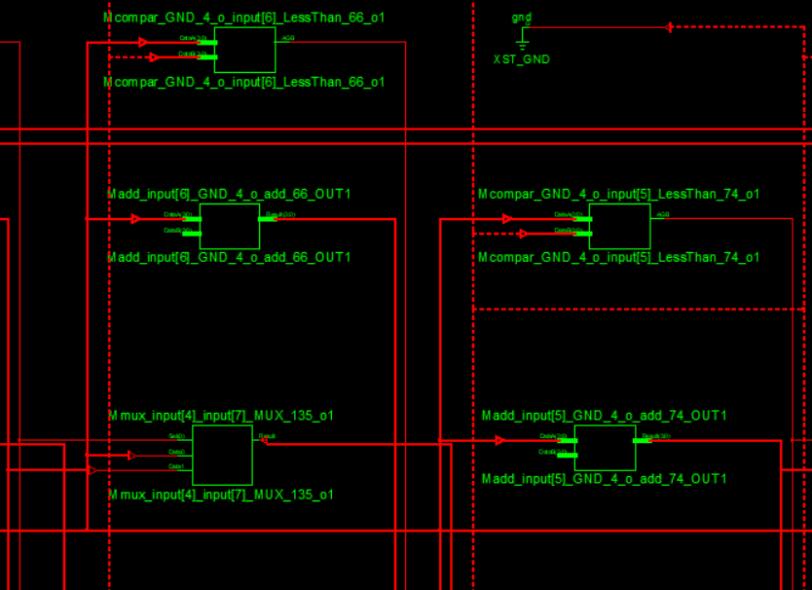
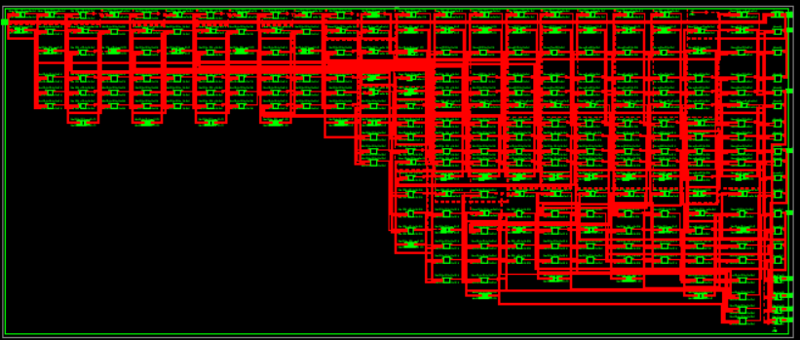
Technology schematic

Slide 24
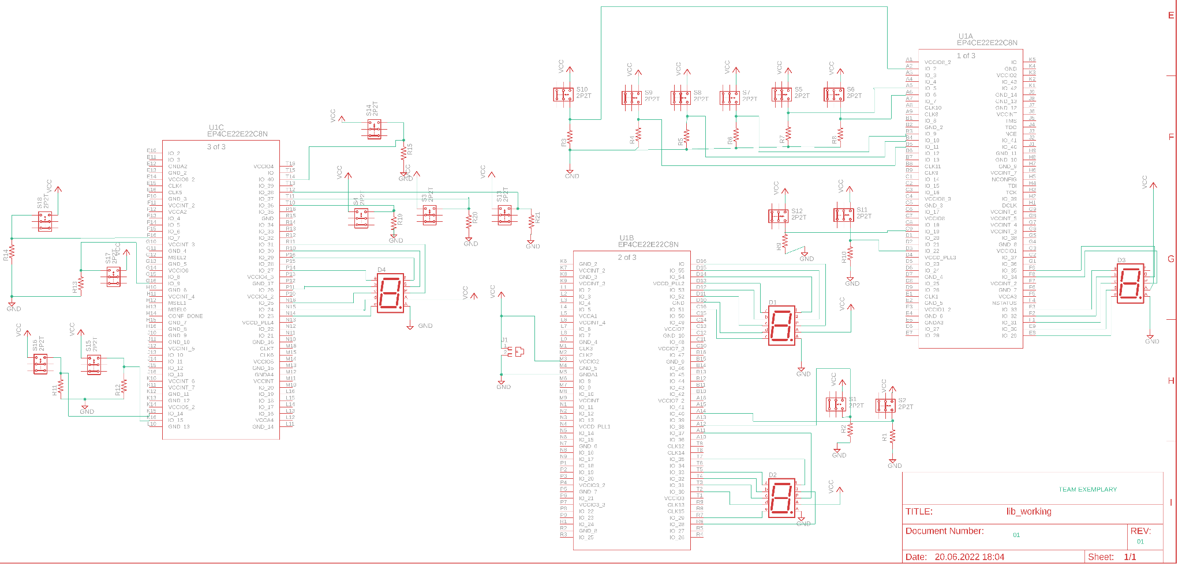
PCB Schematic diagram
Total no of : slide switches - 18.
: 7 Segment LEDs - 4.
: FPGA : 01.

Slide 25
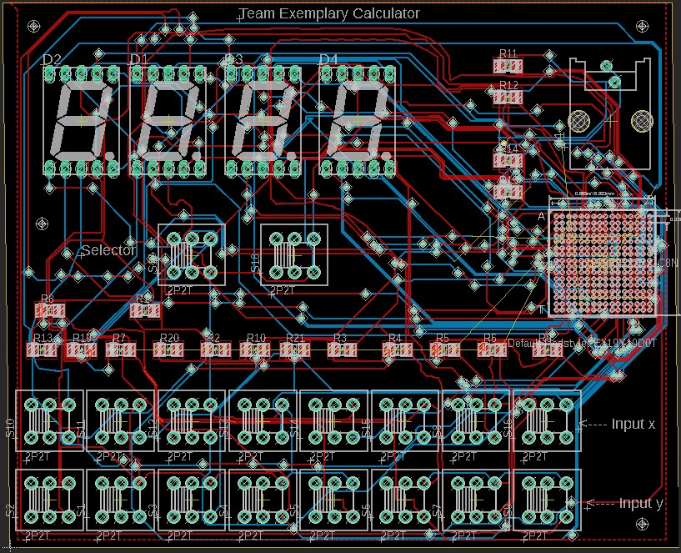
PCB layout
Layout - Size :
4610 x 3453 mil
Auto routing +
manual routing

Slide 26
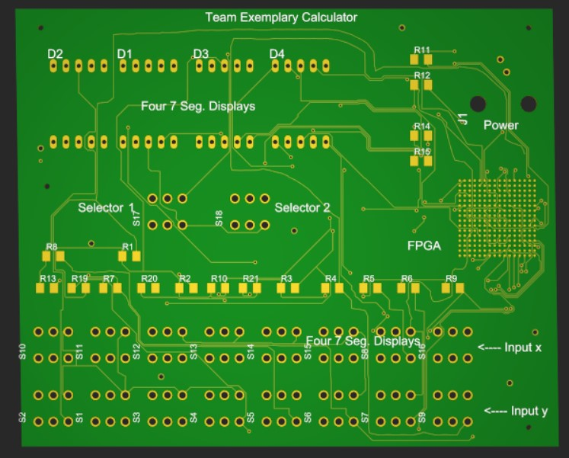
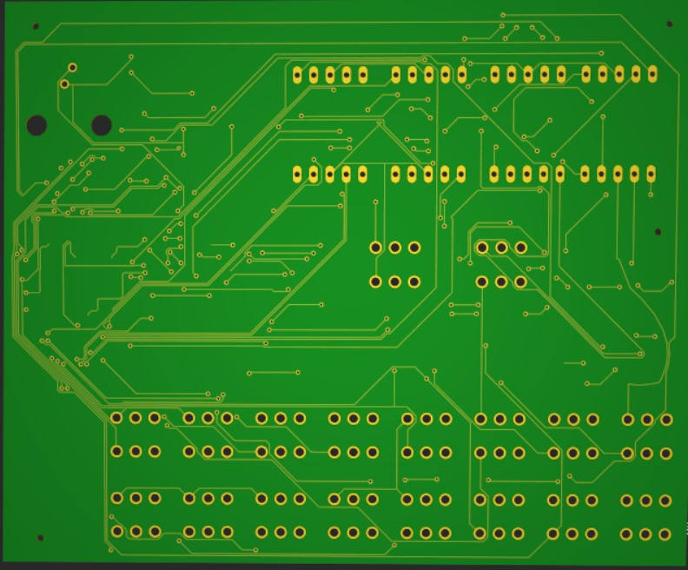
PCB - (Printed Circuit Board)
No. of layers -2
Front View (Top layer)
Rear View (bottom layer)
Track width 6 mil.

Slide 27
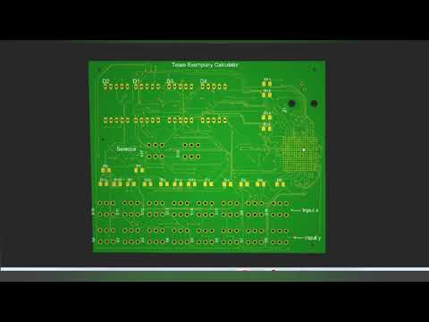

Slide 28
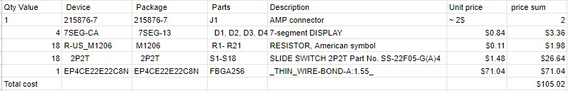
7. BOM List and estimated price of PCB components
Total Component Cost only = ~ $105.02

Slide 29
Further requirements
Testing/refining
Inclusion of Power supply for the PCB.
Implementation of JTAG programmer.
Use of Oscillator/Clock module.
Should meet the EMC Regulations
EMI requirements/tests.
Output/Input ports accessibility. (e.g ;power jack)
Refine the distance between traces.

Slide 30
8. Summary
How to implement combinational and sequential logics in VHDL.
How to simulate VHDL codes using ModelSim.
How to synthesize using Xilinx ISE.
How to choose the right library and components for PCB.
How to design PCB boards using AutoDesk Eagle.

Slide 31
Resources
https://www.facebook.com/cyhardwareengineer/
https://www.101computing.net/binary-subtraction-using-logic-gates/8-bit-subtractor-block-diagram-using-full-adders/

